Slide 1
Angular
A front end development language.

Slide 2
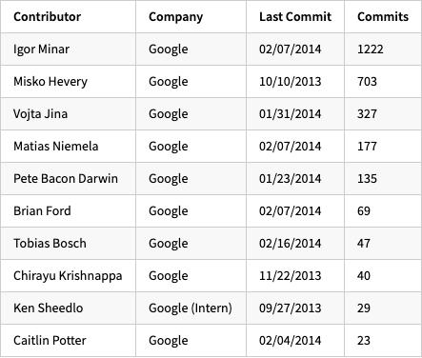
A bit of background
Angular is developed by Google.
Originally released as AngularJS in October 2010.
Was built using JavaScript originally by Misko Hevery and Adam Abrons.
Many of the top contributors did not start at Google?

Slide 3
Google goes all in
Angular 2.0 was release in September 2016.
Was completely rewritten in TypeScript.
Code is transcompiled from Angular-TypeScript to JavaScript that your browser can understand.
The source-to-source compilation consists of three parts: code analysis, code generation, template type checking.

Slide 4
Google goes all in
Angular 2.0 was release in September 2016.
Was completely rewritten in TypeScript.
Code is transcompiled from Angular-TypeScript to JavaScript that your browser can understand.
The source-to-source compilation consists of three parts: code analysis, code generation, template type checking.

Slide 5
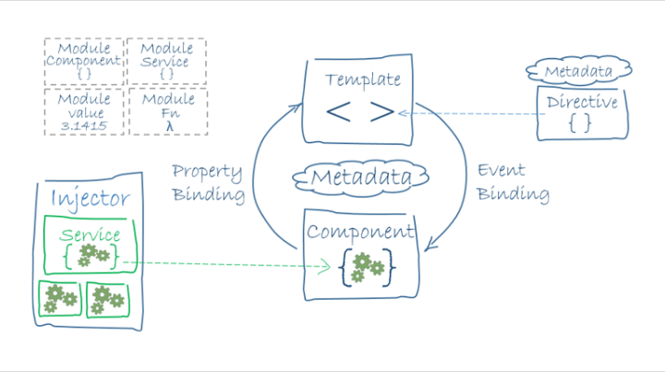
Angular Characteristics
Components
Services
Dependency Injection
Modules
Pipes
Routing

Slide 6
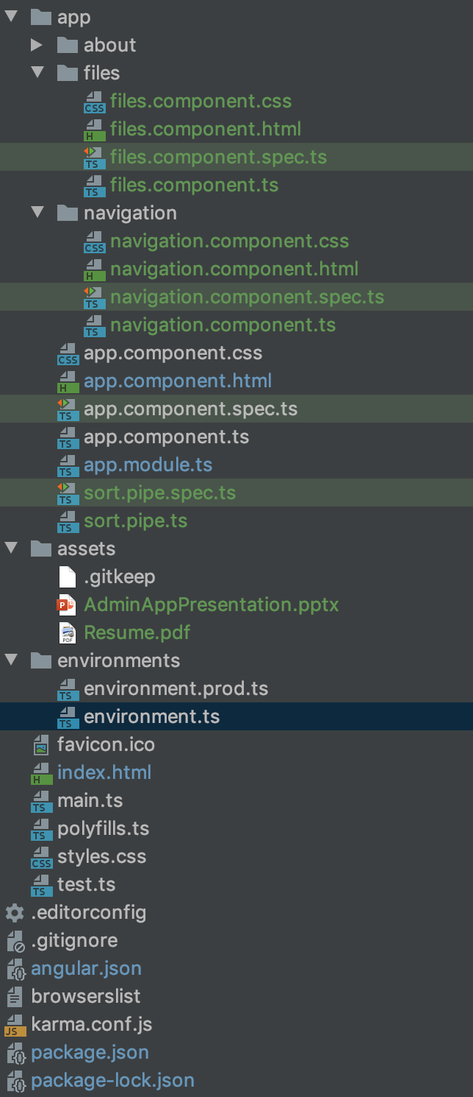
File structure
Component-CSS, HTML, TS, SPEC.TS
{Service, Pipe}-TS, SPEC.TS
Supports TypeScript types like classes, enum, interface, etc..

Slide 7
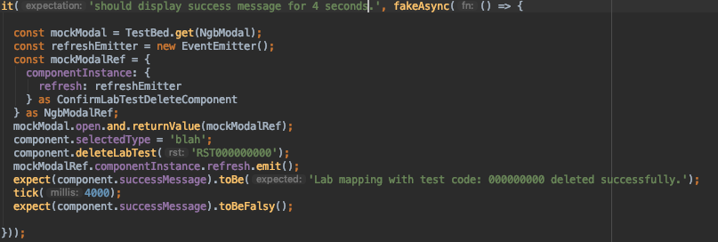
Testing?
Jasmine
Karma

Slide 8
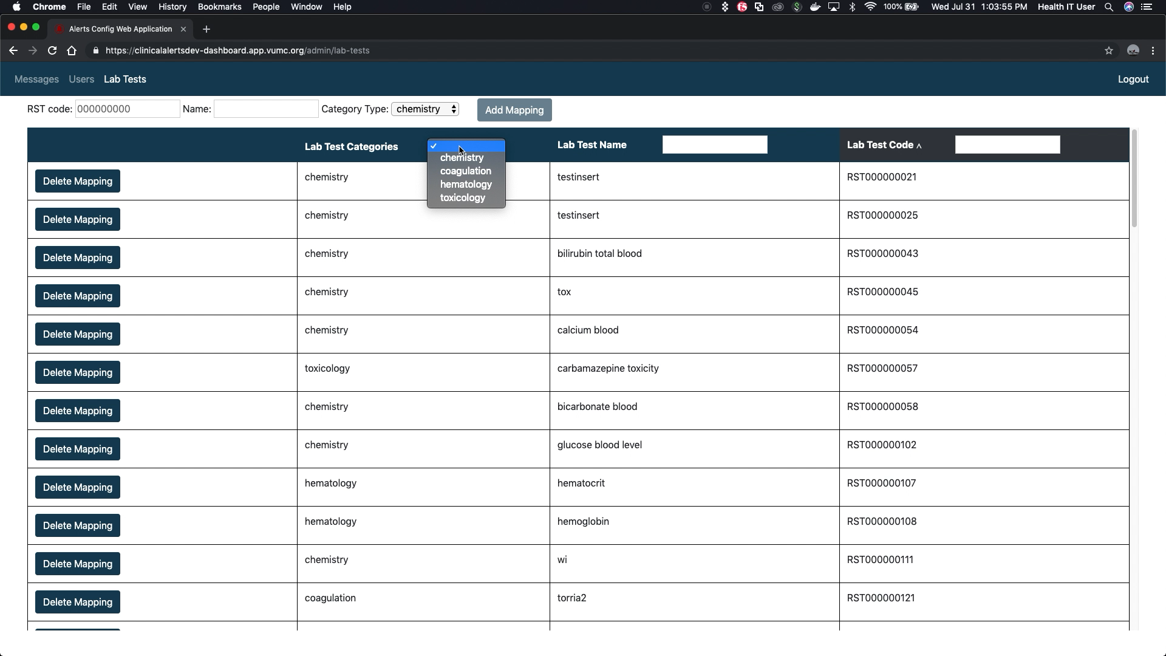
A sneak peak for Monday?

Slide 9
Resources I used:
angular.io – Best Documentation I’ve ever seen for a language.
https://andrewaus tin.com/an-overview-of-angularjs-for-managers/ - A history of AngularJS

